Slide 1
Machine Learning HW6
ML TAs mlta-2023-spring@googlegroups.com

Slide 2
Outline
Task introduction
Dataset & Submit format
Submission & Grading
Useful information

Slide 3
Task introduction

Slide 4
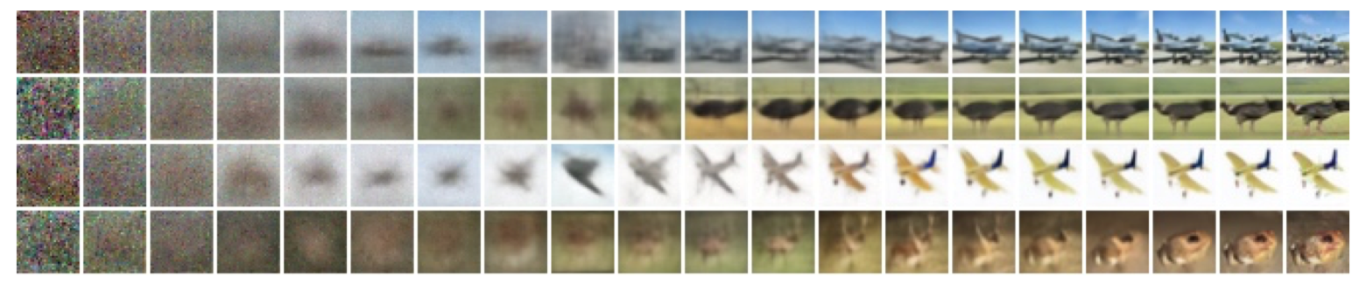
Task introduction - Diffusion Model
Project some random variables into specific space
Diffusion Process: forward process and reverse process
Reverse: Denoising
Forward: Adding noise
Image Source:
https://arxiv.org/abs/2006.11239

Slide 5


Task introduction - Anime face generation
Input: random number
Output: Anime face
Implementation requirement: Diffusion Model
Target: generate 1000 anime face images
Diffusion Model

Slide 6
Task introduction - Evaluation metrics
FID (Frechet Inception Distance) score
Use another model to create features for real and fake images
Calculate the Frechet distance between distribution of two features
Real image
features
mean, std
Inception
Net
Frechet
distance
Fake image
(Generate by yourself)
features
mean, std
Notes:
priority

Slide 7
Task introduction - Evaluation metrics
AFD (Anime face detection) rate
To detect how many anime faces in your submission
The higher, the better

Slide 8
Dataset & Summit format

Slide 9

Dataset & Submit format
Crypko
Website which can generate anime face by yourself
Thanks Arvin Liu for collecting the dataset
Website Link

Slide 10
Dataset & Submit format
Crypko
Dataset link is in the colab
Dataset format
There are 71,314 pictures in the folder
You can use additional data to increase the performance*
faces
|
|__0.jpg
|__1.jpg
|__2.jpg
…
*If you use additional data, please keep the relevant data and we reserve the right to verify additional data.

Slide 11
Submission & Grading

Slide 12
Submission & Grading
You should generate 1000 images, and name each image <number>.jpg
e.g. 1.jpg, 2.jpg, … , 1000.jpg
Use tar to compress your images, and name the file with .tgz as extension.
The untarred files should not contain the folder.
The compressing code is provided in the sample code.
Sample script:
cd <the images folder> && tar -zcvf ../images.tgz *.jpg
The folder containing your generated images should only contain 1000 images.

Slide 13
Submission & Grading - JudgeBoi Rules (1/2)
We do limit the number of connections and request rate for each IP.
If you cannot access the website temporarily, please wait a moment.
The system can be very busy as the deadline approaches.
If this prevents uploads, we do not offer additional submission opportunities.
Please do not attempt to attack JudgeBoi.
Every Saturday from 6:00 to 9:00 is our system maintenance time.
For any JudgeBoi issues, please post on NTUCOOL discussion.
Discussion Link: https://cool.ntu.edu.tw/courses/24108/discussion_topics/182915

Slide 14
Submission & Grading - JudgeBoi Rules (2/2)
5 submission quota per day, reset at midnight.
Guest users have no quota.
Only *.tgz file is allowed, file size should be smaller than 2MB.
Please DO NOT directly upload the anime pictures from internet

Slide 15
Submission & Grading
Leaderboard: JudgeBoi (4%)
Code submission: NTU COOL (2%)
Report submission: Gradescope (4%)

Slide 16
Submission & Grading - Leaderboard
Score | Name | FID score | AFD rate
1% | Simple baseline | FID ≤ 30000 | AFD ≥ 0
1% | Medium baseline | FID ≤ 12000 | AFD ≥ 0.4
1% | Strong baseline | FID ≤ 10000 | AFD ≥ 0.5
1% | Boss baseline | FID ≤ 9000 | AFD ≥ 0.6
Deadline: 2023/4/21 23:59

Slide 17
Submission & Grading - Leaderboard
Baseline | Suggestion | Estimated time
Simple baseline | Just Run Sample Code | 1hr
Medium baseline | data augmentation, More Timestep | 3hr
Strong baseline | Model Arch, Variance Scheduler | 6hr
Boss baseline | styleGAN | 8hr
Notes:
可能做法：更多timestep、兩次diffusion

Slide 18
Submission & Grading - NTU COOL
Compress the code, and submit to NTU COOL, the format is show below
Ex: <student_id>_hw6.zip
Only submit the code you use, do not submit other files (model ,data…)
Deadline: 2023/4/21 23:59

Slide 19
Submission & Grading - Gradescope
Report questions:
Sample 5 images and show the progressive generation. Then, briefly describe their differences in different time steps.
Canonical diffusion model (DDPM) is slow during inference, Denoising Diffusion Implicit Model (DDIM) is at least 10 times faster than DDPM during inference, and preserve the qualities.
Please describe the differences of training, inference process, and the generated images of the two models respectively. Briefly explain why DDIM is faster.
Notes:
如何做到condition的generation
spicify問題在模型訓練的方法、模型的架構

Slide 20
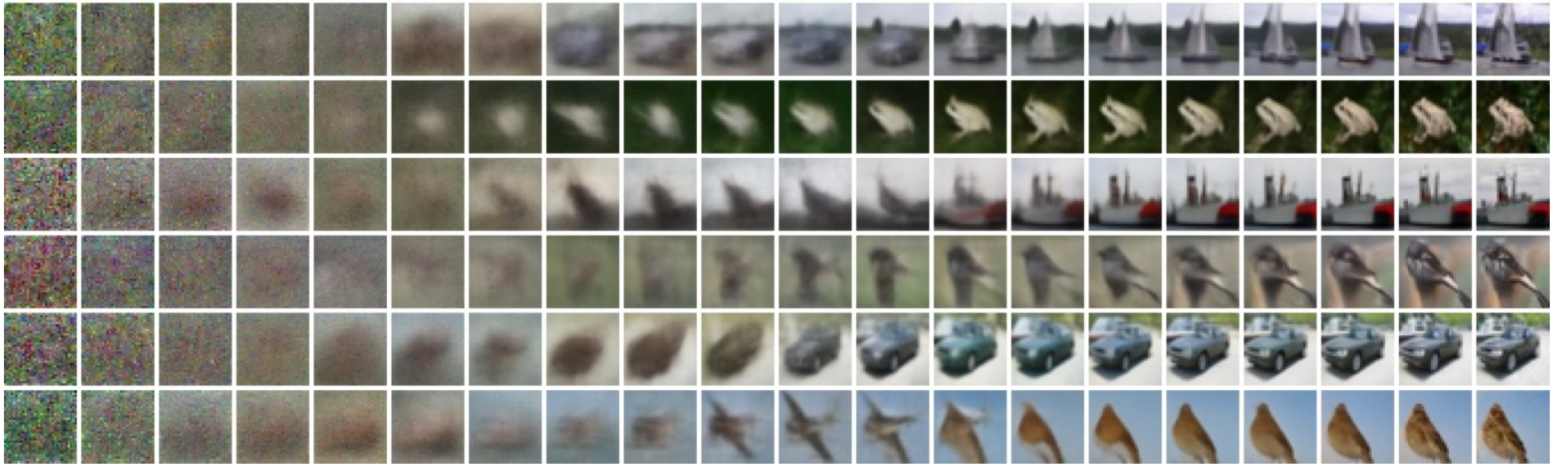
Gradescope – Question 1
Sample 5 images and show the progressive generation. Then, briefly describe their differences in different time steps.
https://arxiv.org/abs/2006.11239
Notes:
Show the images diffuse with different time steps, and briefly describe their differences.

Slide 21
Gradescope – Question 2
Canonical diffusion model (DDPM) is slow during inference, Denoising Diffusion Implicit Model (DDIM) is at least 10 times faster than DDPM during inference, and preserve the qualities.
Please describe the differences of training, inference process, and the generated images of the two models respectively. Briefly explain why DDIM is faster.

Slide 22
Submission & Grading - Gradescope
Report submission:
Submit the files on gradescope
Deadline: 2023/4/21 23:59

Slide 23
Regulations
You should NOT plagiarize, if you use any other resource, you should cite it in the reference.(*)
You should NOT modify your prediction files manually.
Do NOT share codes or prediction files with any living creatures.
Do NOT use any approaches to submit your results more than 5 times a day. Do NOT use pre-trained models.
Your assignment will not be graded and your final grade x 0.9 if you violate any of the above rules.
Prof. Lee & TAs preserve the rights to change the rules & grades.
(*) Academic Ethics Guidelines for Researchers by the Ministry of Science and Technology (MOST)

Slide 24
Notice
助教們會優先回答NTU Cool討論區上的問題，如果同學的問題不涉及作業答案或隱私，請同學們善用NTU Cool討論區。若真的需要私下詢問助教，再以信件開頭[hw6]寄到助教信箱。

Slide 25
Useful Links
Course Website
NTU COOL
JudgeBoi
Gradescope
sample_code
Notes:
待捕上Links

Slide 26
Deadline
Leaderboard: JudgeBoi
2023/04/21 23:59 (UTC+8)
Code submission: NTU COOL
2023/04/21 23:59 (UTC+8)
Report submission: Gradescope
2023/04/21 23:59 (UTC+8)
Notes:
待確認Deadline

Slide 27
Useful information

Slide 28
Link
秘密武器

